Slide 1
SMART STREET MANAGEMENT SYSTEM
Group Members:
Abdullah Hussain
Jaweria Manahil
Saif Sheikh
Sara Adnan
Zainab Athar

Slide 2
Objectives
Automate street lighting based on light + motion
Reduce energy consumption & maintenance
Detect vehicle overspeeding automatically
Alert authorities via buzzer
Provide data for traffic planning

Slide 3
01
SMART STREET LIGHTS SYSTEM

Slide 4
Smart Street Lights
It is a power-saving substitute to the manual light switching system by involving lights that adapt to surrounding light intensity.
Efficient motion-based streetlights – illuminating only when an object is in close proximity.
It incorporates working principle of LDR to minimize energy consumption.

Slide 5

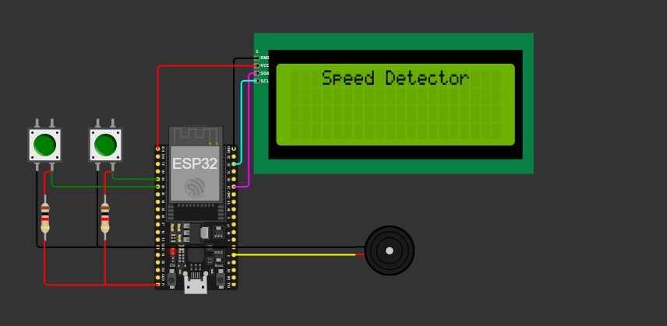
CIRCUIT DIAGRAM:

Slide 6
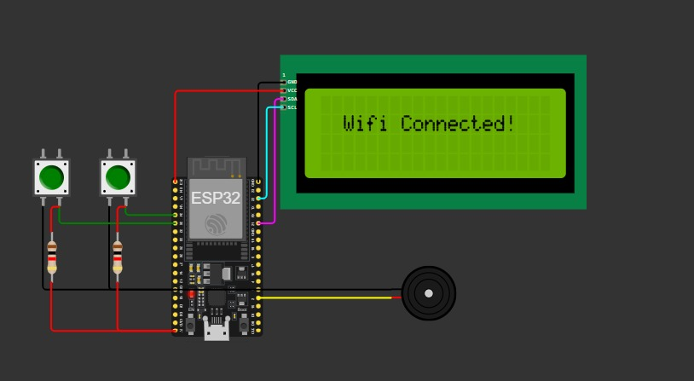
CIRCUIT DIAGRAM:

Slide 7
02
VEHICLE SPEED DETECTION

Slide 8
Vehicle Speed Detection
Over speeding is one of the major causes of road accidents. Our system helps to detect speed violation via integrating ESP32 with motion sensors.
Serves as an efficient replacement for manual LIDAR and RADAR guns.
In case of over speeding, voltage is supplied to the buzzer, and it starts ringing to alert offenders and relevant authorities.

Slide 9
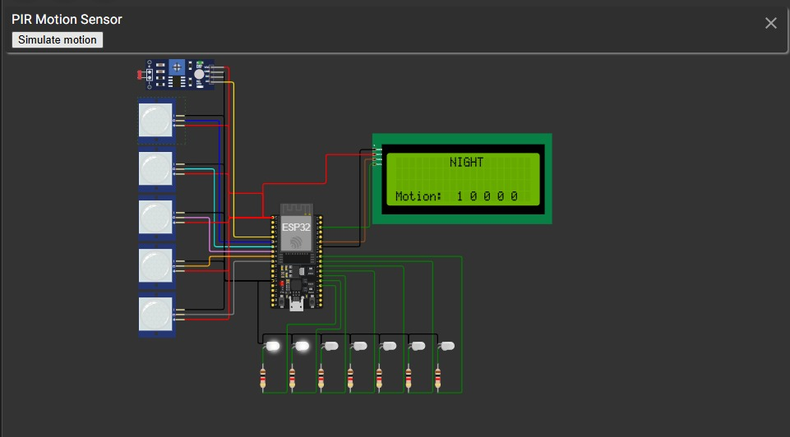
CIRCUIT DIAGRAM:

Slide 10
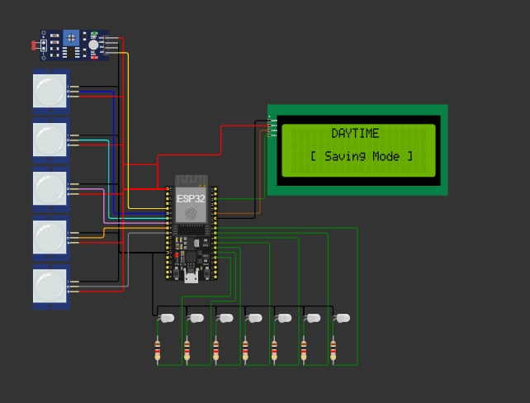
CIRCUIT DIAGRAM:

Slide 11
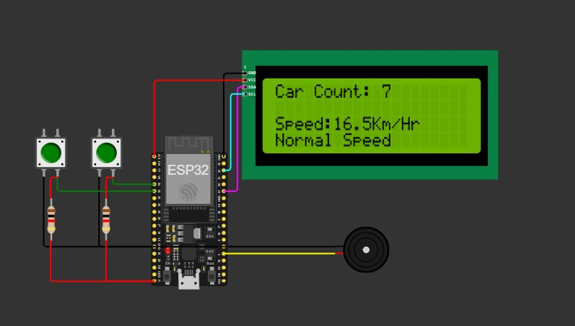
CIRCUIT DIAGRAM:

Slide 12
Aims and Objectives:
01
02
03
Increase Energy Savings by Automation
Reduce Maintenance Checks
Minimize Road Accidents
04
05
06
Reduce Manual Labour
Data-Driven Urban Planning
Lower Carbon Footprint

Slide 13
Impact of Project:
01
02
03
Efficient Energy Utilization
Mitigating Light Pollution
Advancing Safety on Streets
04
05
06
Traffic Speed Management
Data-Driven Urban Planning
Setting up Sustainable Eco-friendly system

Slide 14
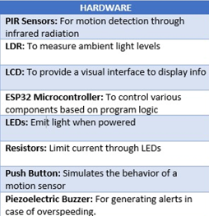
APPLICATION REQUIREMENTS:

Slide 15
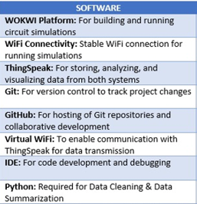
APPLICATION REQUIREMENTS:

Slide 16


Communication Technologies
Physical Layer
Internet Layer
Application Layer
HTTP
WiFi connection between Wokwi and ThingSpeak
Esp32 Communicates Over The Internet Using Internet Protocol (IP)
HTTP request to ThingSpeak servers by Wokwi ESP32

Slide 17
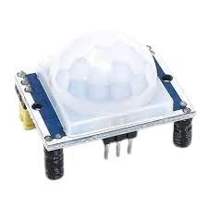
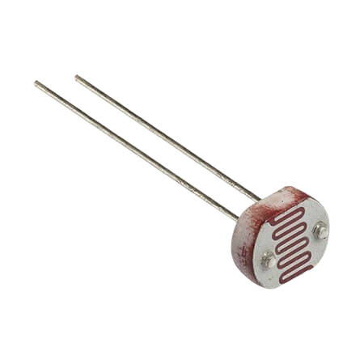
Power Consumption
PIR Sensor
LDR Sensor
Idle State = 40 µA Active State = 400 µA
Active State: 100mA

Slide 18
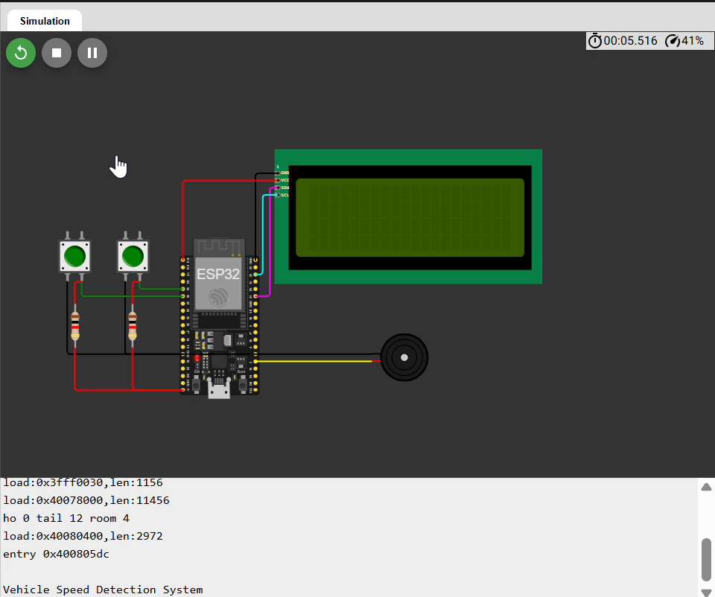
DEMO VIDEO – SMART STREET LIGHTS SYSTEM

Slide 19
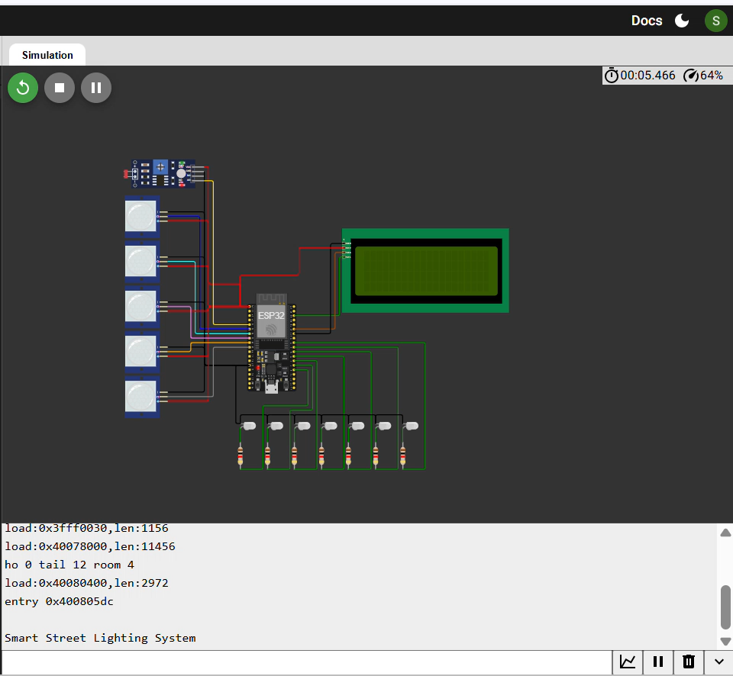
DEMO VIDEO - VEHICLE SPEED DETECTION

Slide 20
THANK YOU!

